Slide 1
Equations of Lines
BEFORE BEGINNING THIS MODULE, MAKE SURE YOU ARE ONLY USING THE MOZILLA FIREFOX OR GOOGLE CHROME BROWSER. DO NOT USE INTERNET EXPLORER!!

Slide 2
Equations of Lines
PLEASE READ ALL DIRECTIONS CAREFULLY!!
Today you will begin/complete a module, but first a few computer lab norms:
1) NO FOOD OR DRINK IN THE LAB
2) NO CELL PHONES – ZERO TOLERANCE!
3) NO MUSIC WEBSITES OF ANY SORT
4) DO NOT TOUCH ANYTHING BESIDES THE COMPUTER STATION YOU’RE USING
5) NO LOUD TALKING
6) BE MINDFUL OF POWER CORDS

Slide 3
Equations of Lines
WARM UP – 5 MINUTES
TO BE COMPLETED ON YOUR WARM UP PAPER.
1. Graph the equation 5x + 2y = 10 using intercepts. Use your graph paper from yesterdays warm up.

Slide 4
Equations of Lines
Equations of Lines
ONLINE MODULE
Tuesday, October 25, 2016
TARGETS
Write an equation of a line given information about the graph.
Solve problems by writing equations.

Slide 5
Equations of Lines
Content Standards
A-AF1 Solve problems involving applications of linear equations
M-SG1 Graphically represent the solution to a linear equations and the solution to a system of linear equations in two variables.
Mathematical Practices
2 Reason abstractly and quantitatively.
3 Construct viable arguments and critique the reasoning of others.
6 Attend to precision.
8 Look for and express regularity in repeated reasoning.

Slide 6
Equations of Lines
Essential Question:
Is it true that a line with a slope of 1 always passes through the origin? Explain your reasoning.

Slide 7
Equations of Lines
Completing the Module
Step 1) Copy the following objectives in your notes:
Write an equation of a line given information about the graph
Solve problems by writing equations of lines
Step 2) Review the remaining slides in this Powerpoint (you must click through each slide, it is not automated), directions will continue after the end of the slideshow.

Slide 8
Equations of Lines
LESSON 3-3: Equations of Lines
Nonvertical Line Equations
Slope-intercept form
Point-slope form
y = mx + b

Slide 9
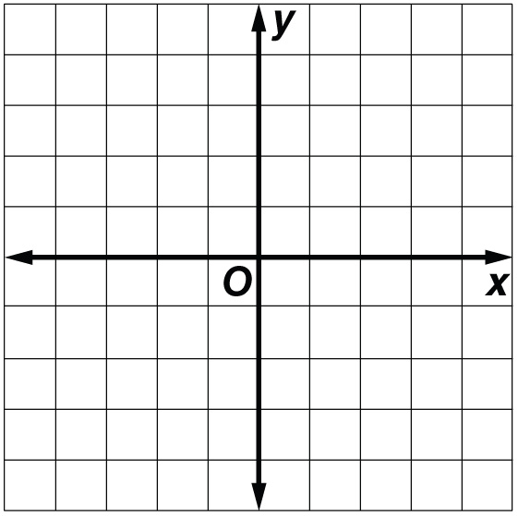
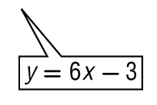
Equations of Lines
EXAMPLE 1
Slope and y-intercept
Write an equation in slope-intercept
form of the line with slope of 6 and
y-intercept of –3. Then graph the line.
Answer:
y = mx + b Slope-intercept form
y = 6x + (–3) m = 6, b = –3
y = 6x – 3 Simplify.
Use the slope of 6 or to find another point 6 units up and 1 unit right of the y-intercept.
Plot a point at the y-intercept, –3.
Draw a line through these two points.

Slide 10
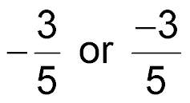
Equations of Lines
EXAMPLE 2
Slope and a Point on the Line
Write an equation in point-slope form of the line whose slope is that contains (–10, 8). Then graph the line.
Point-slope form
Answer:
Graph the given point (–10, 8).
Use the slope to find another point 3 units down and 5 units to the right.

Slide 11
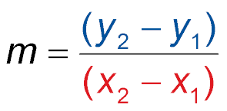
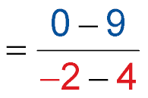
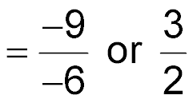
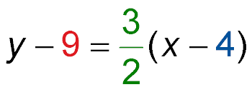
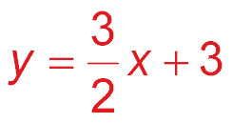
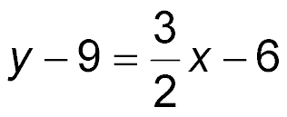
Equations of Lines
EXAMPLE 3
Two Points
A. Write an equation in slope-intercept form for a line containing (4, 9) and (–2, 0).
Step 1 First find the slope of the line.
Slope formula
Step 2 Now use the point-slope form and either point to write an equation.
Using (4, 9):
Point-slope form
Answer:

Slide 12
Equations of Lines
EXAMPLE 3
Two Points
B. Write an equation in slope-intercept form for a line containing (–3, –7) and (–1, 3).
Step 1 First find the slope of the line.
Slope formula
Step 2 Now use the point-slope form and either point to write an equation.
Using (4, 9):
Point-slope form
Answer:

Slide 13
Equations of Lines
EXAMPLE 4
Horizontal Line
Write an equation of the line through (5, –2) and (0, –2) in slope-intercept form.
Step 1
This is a horizontal line.
Slope formula
Step 2
Answer:

Slide 14
Equations of Lines
Completing the Module (cont.)
Step 3) View the video clip Find the Equation of a line Using Point-Slope Form
Step 4) View the video clip Equation of a Line Given a Slope and a Point
Step 5) Open the worksheet Writing Equations of Line Online Module (in the Online Modules section) and complete items 2, 6, 10, 12, 16, and 20 all on a separate sheet of paper. Hand in before you leave.

Slide 15
Equations of Lines
Closure
1) Check your work area before you leave.
2) Close all computer programs, but do log off.
3) Return all calculators.
4) Take your personal belongings.
HAVE A GREAT DAY!

